Slide 1
scRNA: Study design
Acquired cancer resistance to combination immunotherapy from transcriptional loss of class I HLA》PMID: 30250229。Illumina HiSeq 2500，GSE117988, 6 Merkel cell carcinoma （MCC）samples：
4 PBMC samples divided according to treatment point，四个时间点：
SRR7722939 GSM3330561 | PBMC Pre，
SRR7722940 GSM3330562 | PBMC Disc Early，day +27(Early)
SRR7722941 GSM3330563 | PBMC Disc Resp，day+37
SRR7722942 GSM3330564 | PBMC Disc AR，+614 (AR)
Paper cell type annotation：nine distinct clusters，CD4+ T cells, CD8+ T cells, CD8+ effector T cells, B cells, NK cells, CD14+ monocytes, CD16+ monocytes, myeloid cells and dendritic cells.

Slide 2
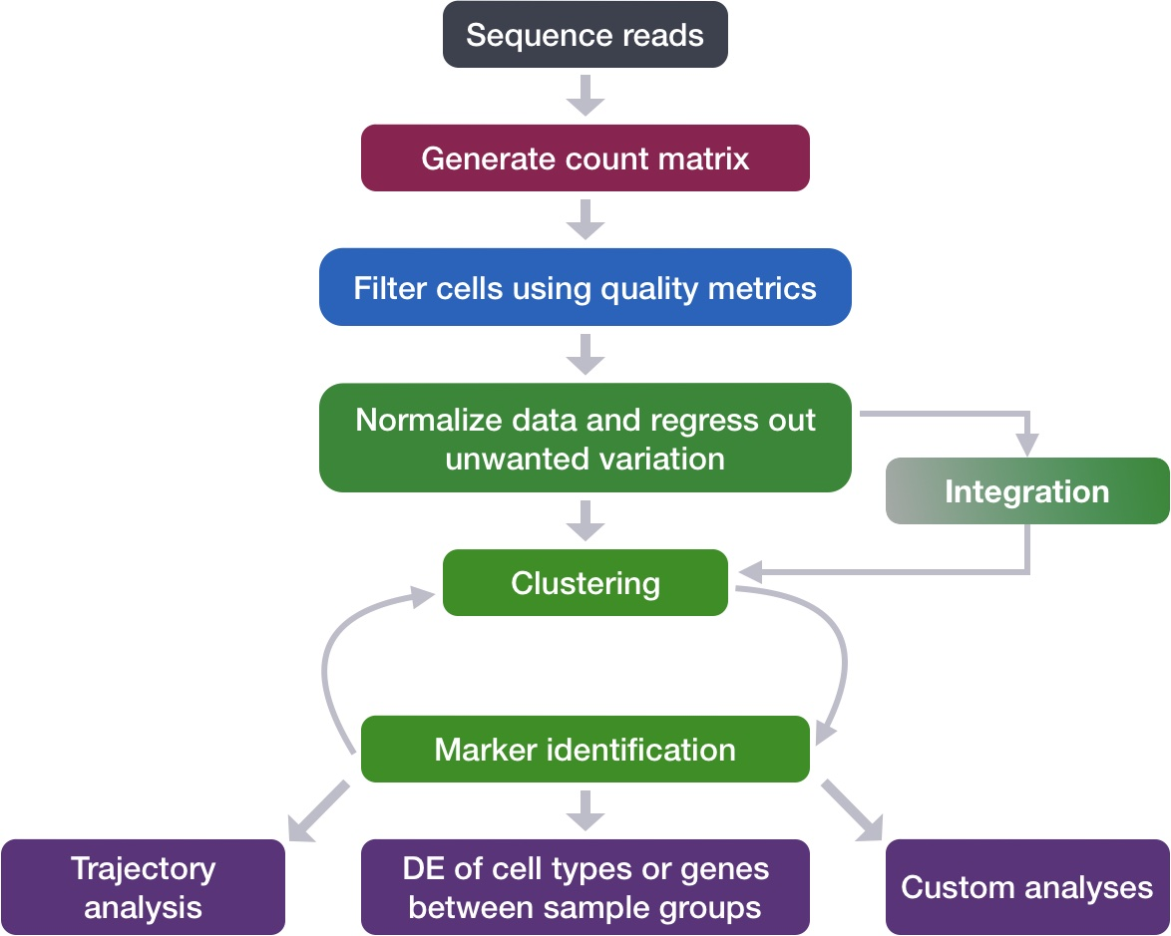
Analysis workflow chart
Linear (PCA) and non-linear dimension reduction (UMAP, TSNE)
Filtering mito genes, ribo genes, hb genes
Harmony, *CCA, *rPCA, *SCTransform
*Cell cycling scoring,
Doublet removal
Remove zero count genes more than 10 cells
Findneighbors() based on graph, knn
Findclusters() with various resolutions
manual using cell Markers:
Bio knowledge, literature
Automated tools: SingleR (leveraging reference transcriptomic datasets of pure cell types)

Slide 3
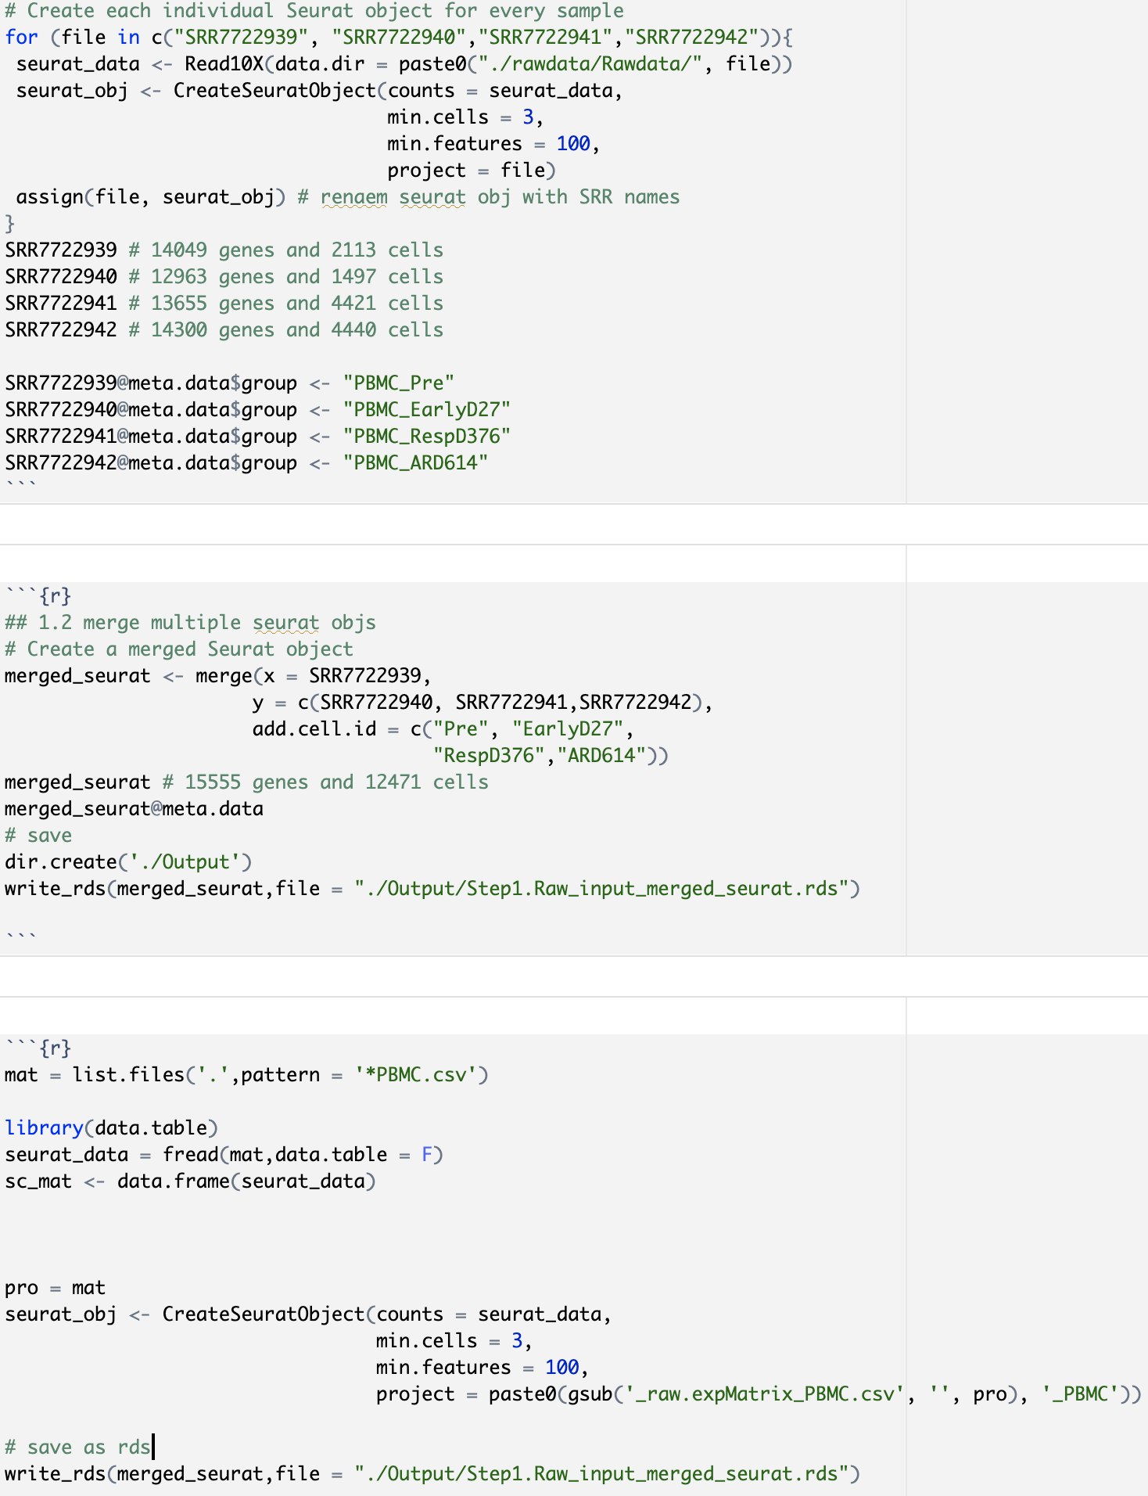
Import dataset

Slide 4
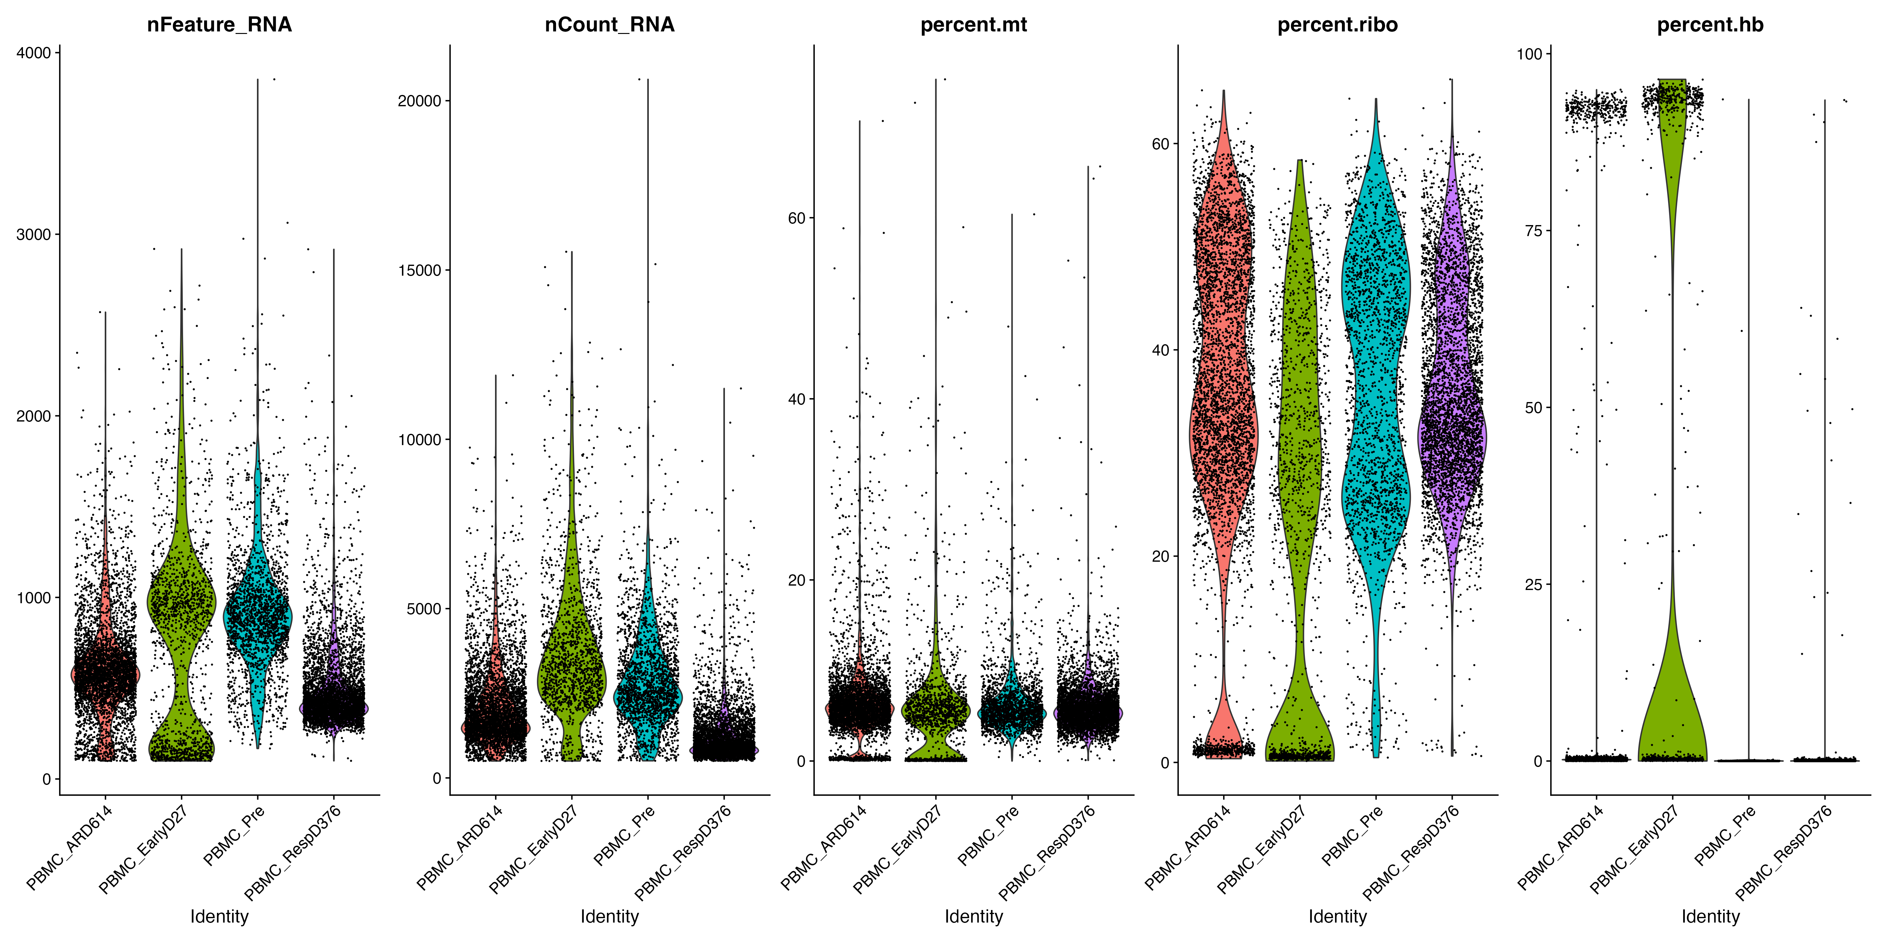
QC
Goals:
filter the data to only include true cells that are of high quality
identify failed samples
Salvage if possible
Else remove them from analysis
Challenges:
Delineating cells that are poor quality from less complex cells
Choosing appropriate thresholds for filtering
Item | Threshold / number
Read count per cell | > 500
Number of genes per cell | > 250 & < 2500
Read counts per gene | > 10
Percentage mitochondrial genes | < 15 %
Initial number of cells: 12471
Initial number of genes: 15555
Final number of cells: 11291
Final number of genes: 13461

Slide 5
Normalization and regressing out unwanted variation, Correct Batch Effect, Integration
Goals:
to account for differences in sequencing depth and overdispersed count values.
To identify the most variant genes likely to be indicative of the different cell types present.
To align same cell types across conditions.
Challenges:
Checking and removing unwanted variation so that we do not have cells clustering by artifacts downstream
Aligning cells of similar cell types so that we do not have clustering downstream due to differences between samples, conditions, modalities, or batches

Slide 6
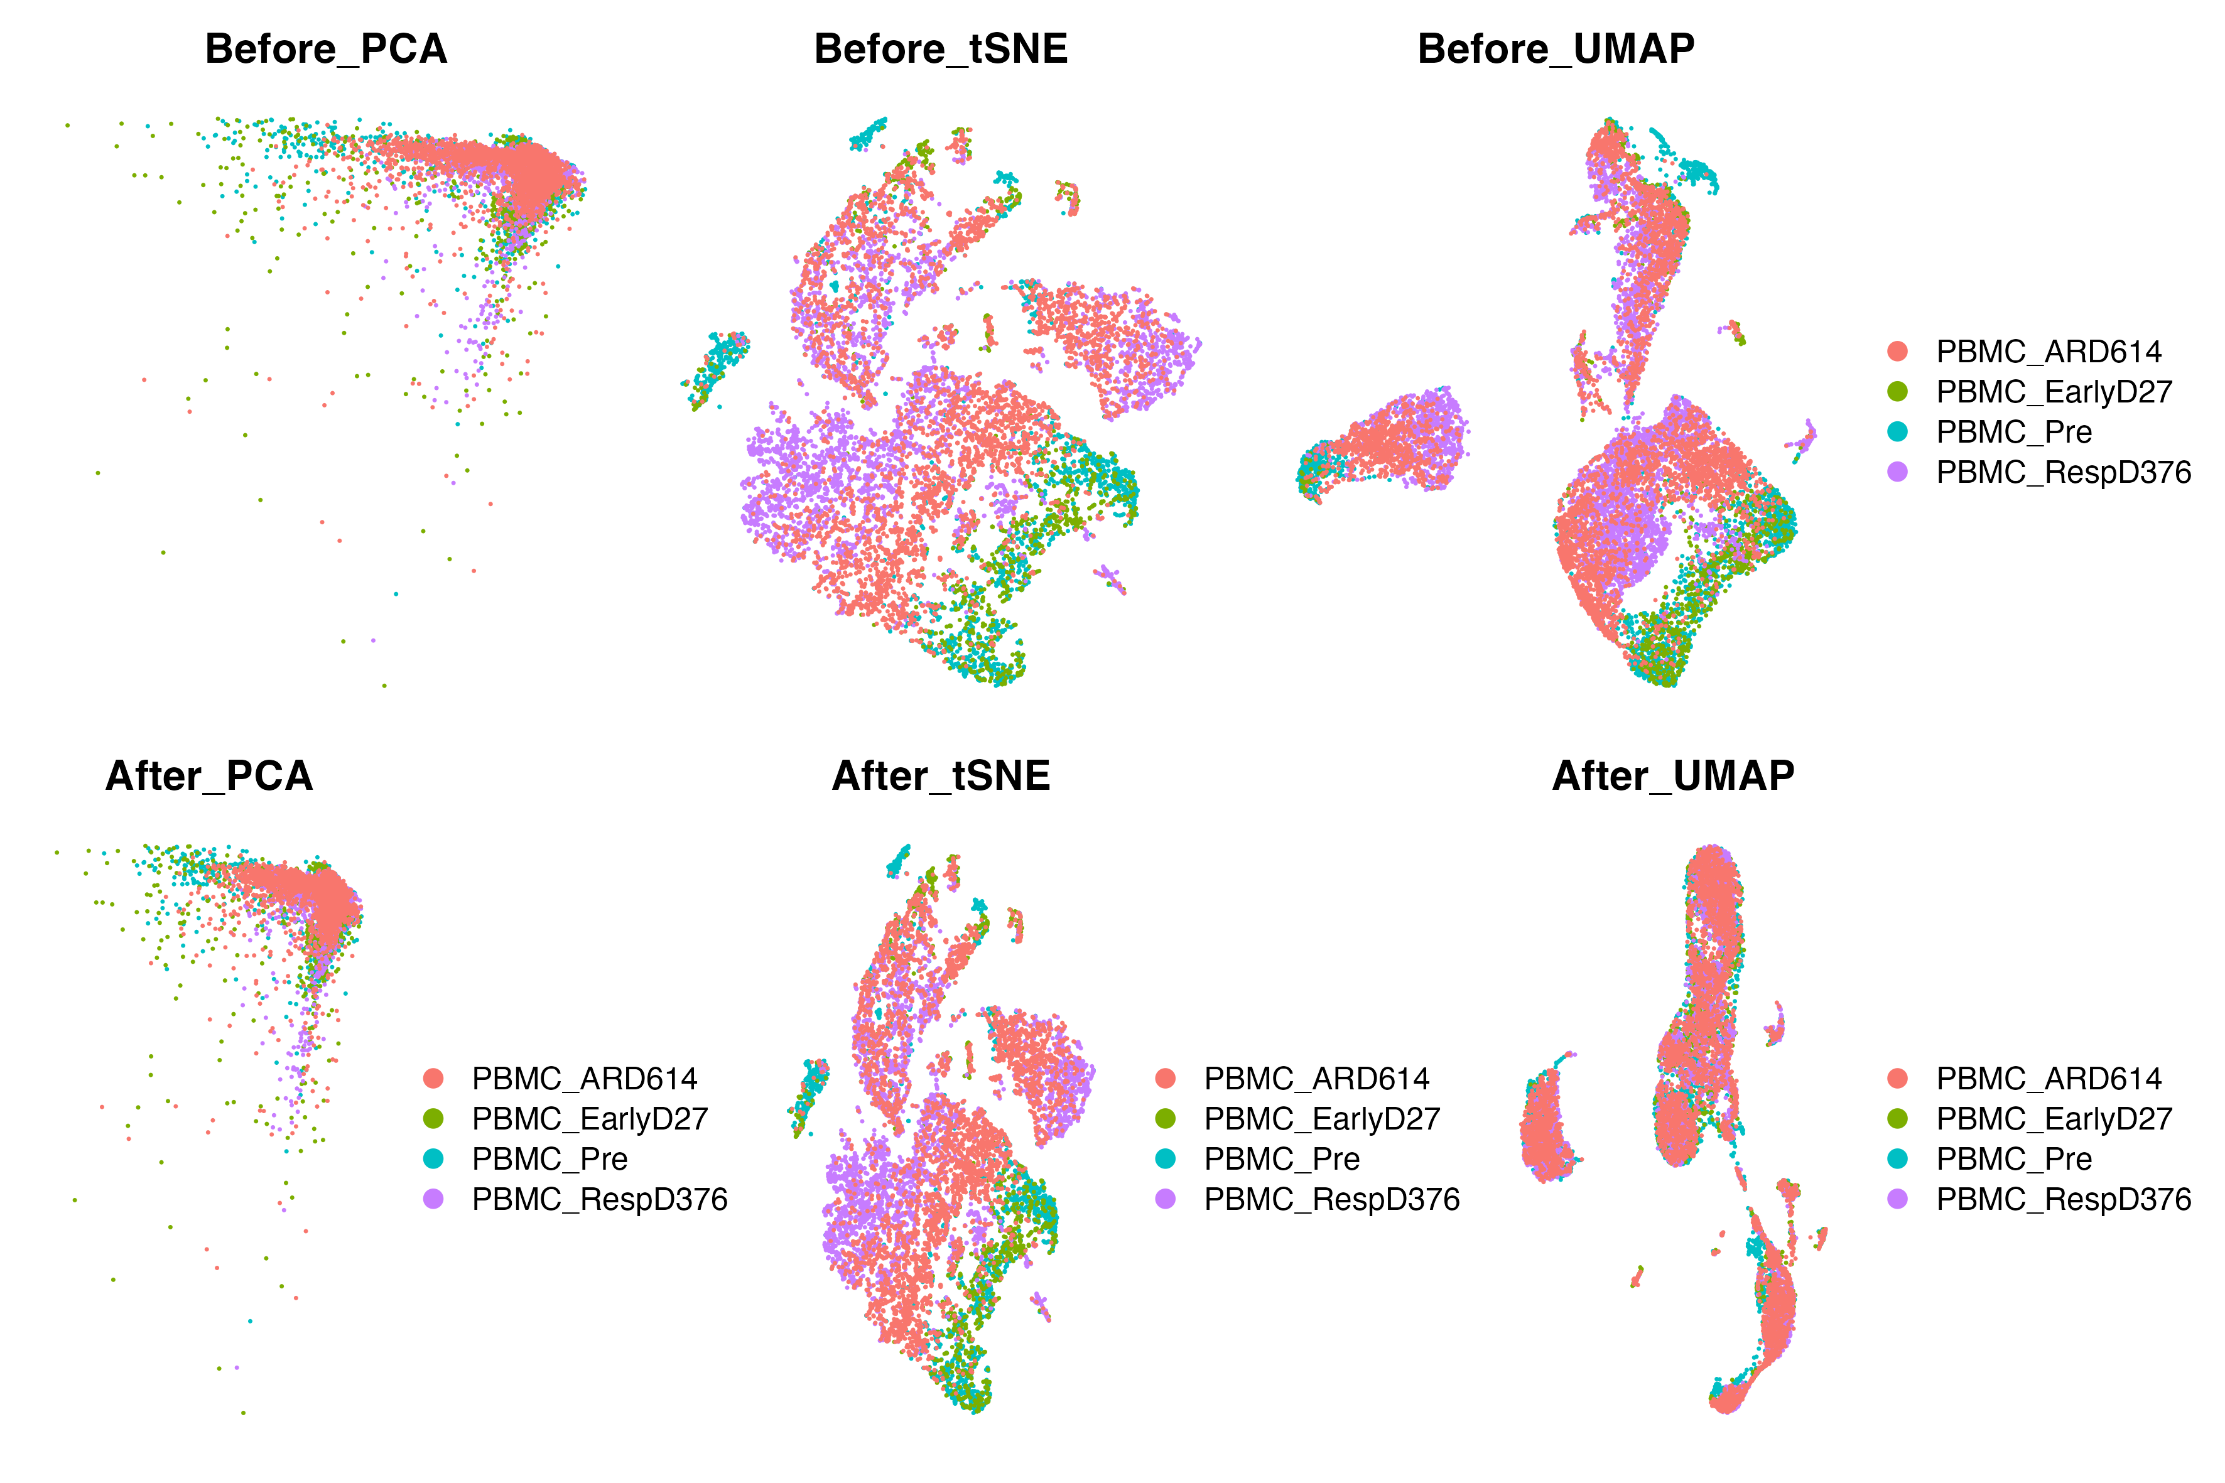
Removing batch effect: Harmony integration

Slide 7
Downstream analysis-clustering and cell type annotation
Goals:
To generate cell type-specific clusters and use known cell type marker genes to determine the identities of the clusters.
To determine whether clusters represent true cell types or cluster due to biological or technical variation, such as clusters of cells in the S phase of the cell cycle, clusters of specific batches, or cells with high mitochondrial content.
Challenges:
Identifying poor quality clusters that may be due to uninteresting biological or technical variation
Identifying the cell types of each cluster
Maintaining patience as this can be a highly iterative process between clustering and marker identification (sometimes even going back to the QC filtering)

Slide 8
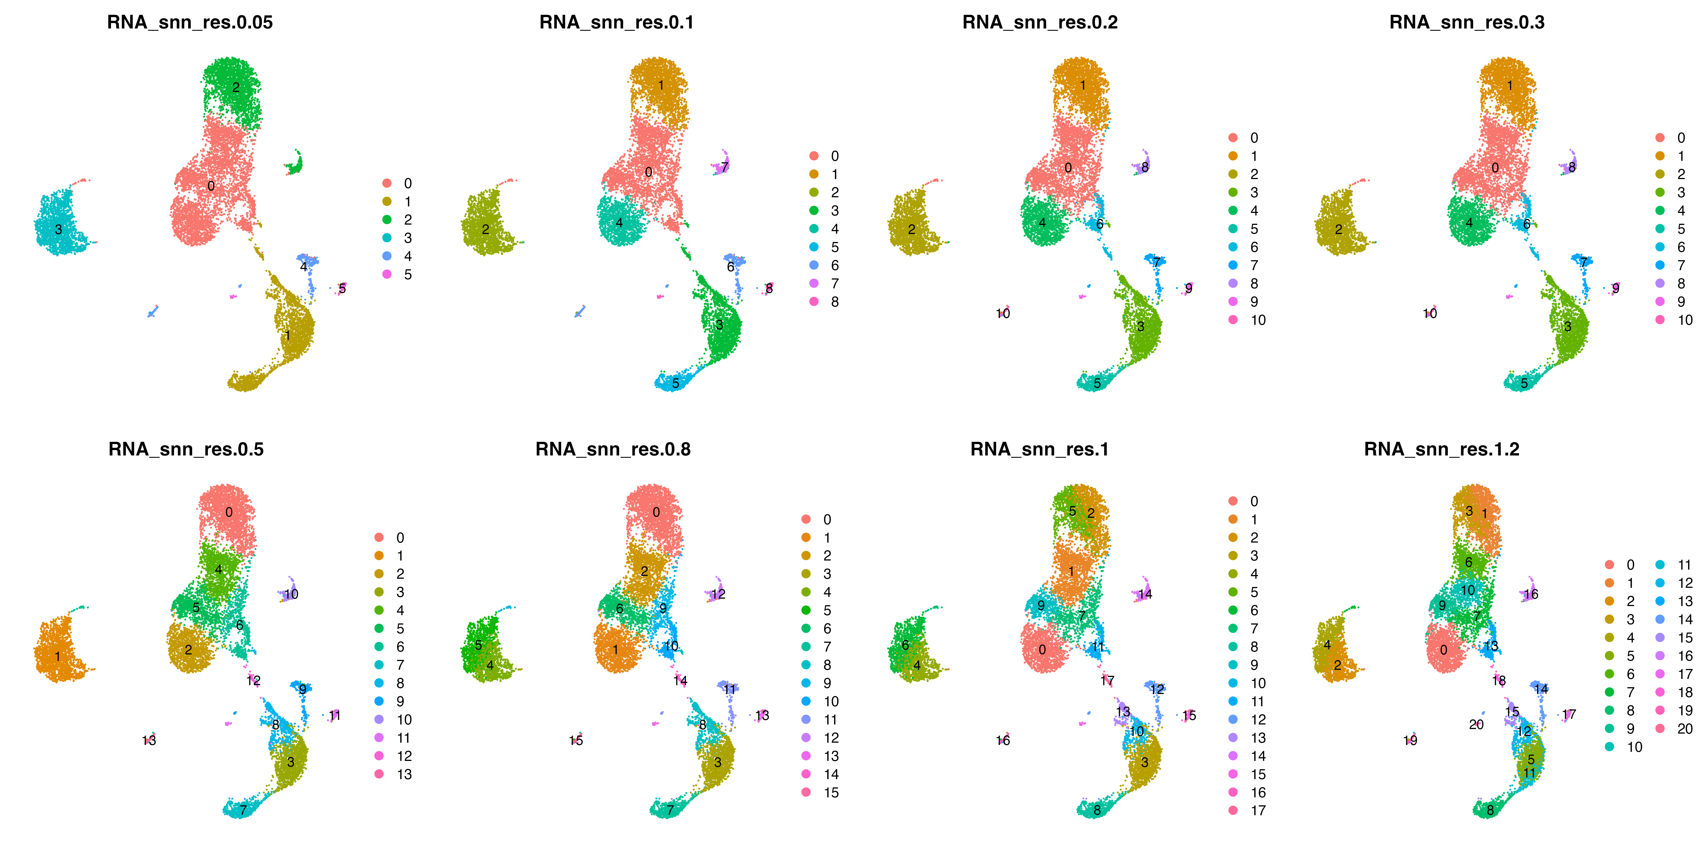
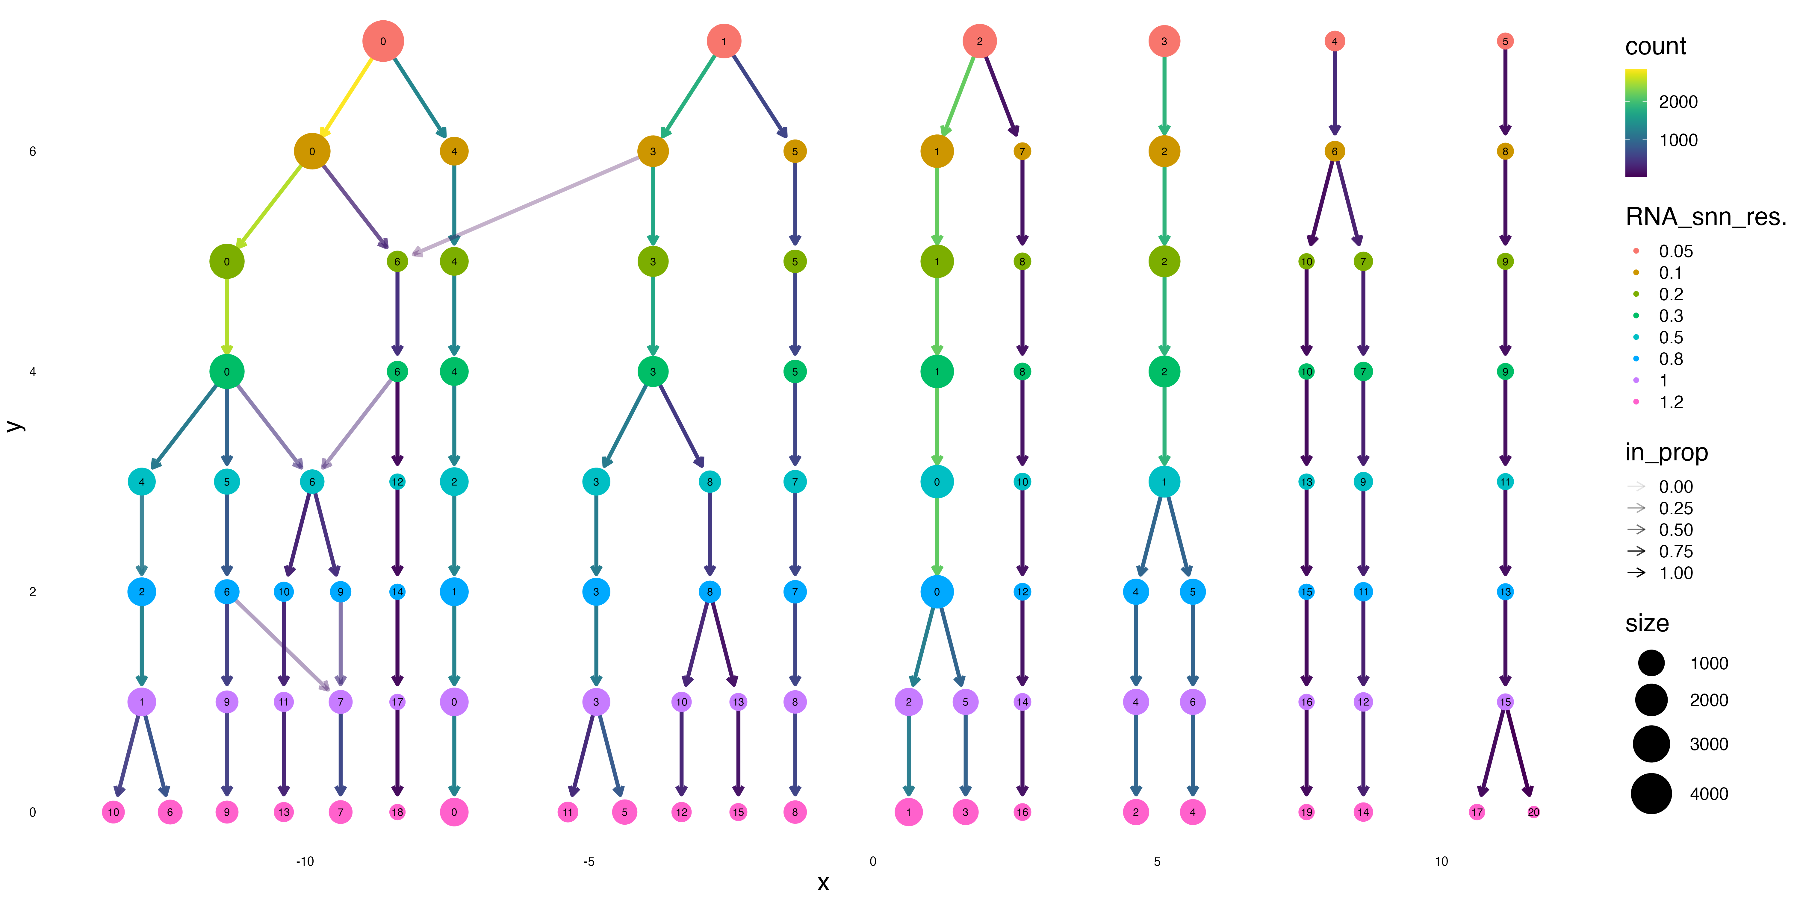
Choose res= 0.5

Slide 9
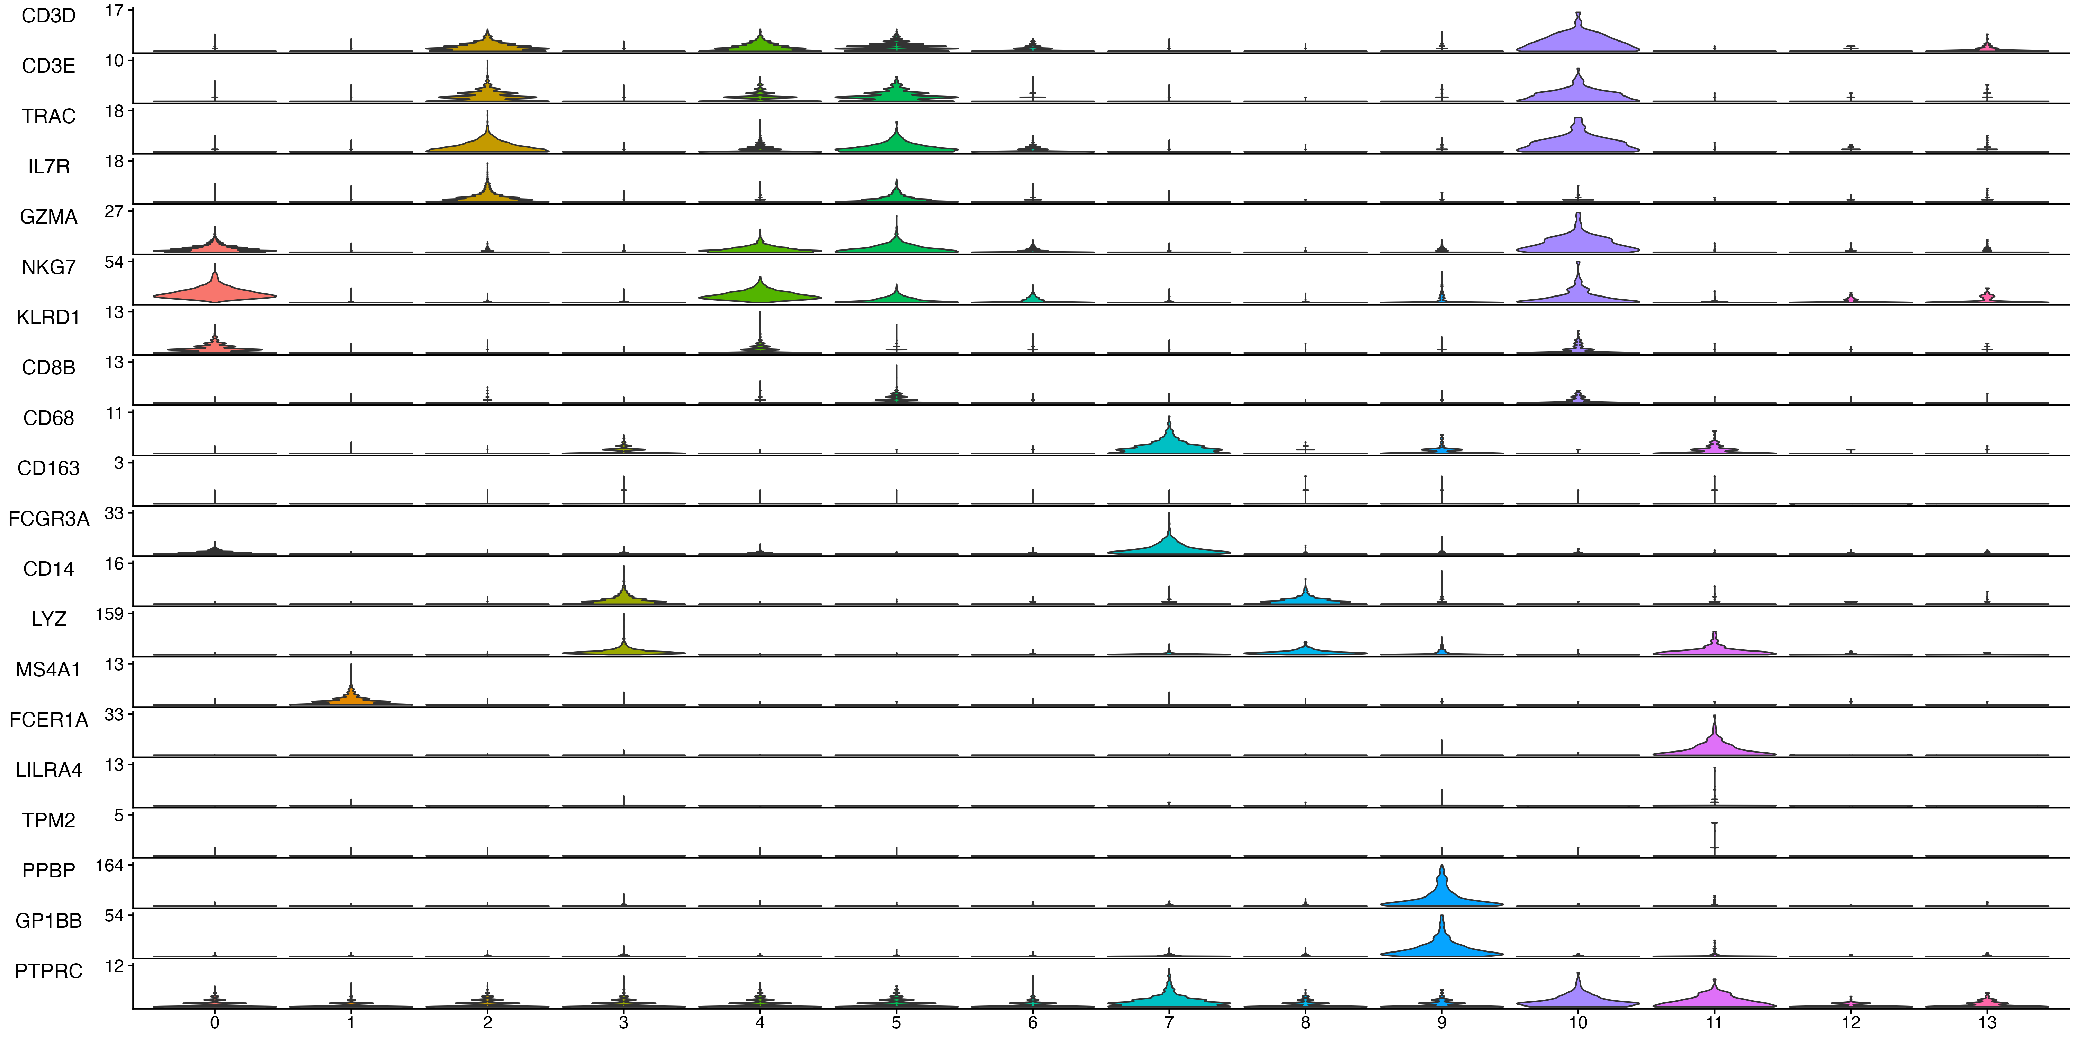
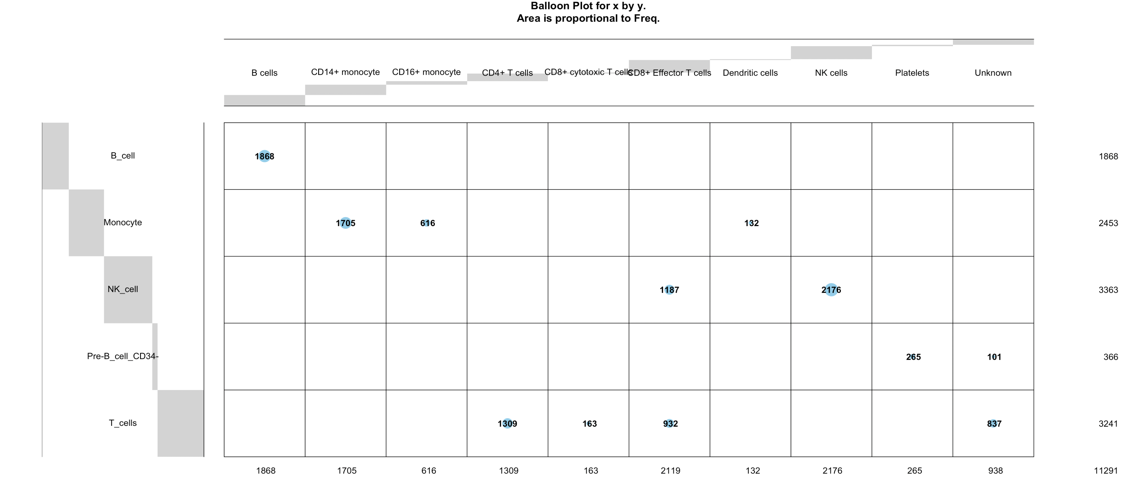
Challenge: ambiguous cell type annotation based on automate SingleR and manual
Conclusion: Matched ones are quite accurate; Unknown is possibly T cells but based on markers I used it is challenging to distinguish among which subtype of T cells; small portion is likely pre-B cell based on SingleR annotation
Notes:
HumanPrimaryCellAtlasData()
SingleR is an R package designed to transfer cell type annotations from a reference dataset to a query dataset. The package uses a machine learning approach to classify cells in the query dataset based on gene expression profiles.
Here is an overview of the working mechanism of SingleR:
Load and preprocess reference and query datasets: The reference and query datasets are loaded into R and preprocessed using standard normalization and quality control methods.
Train a classifier: SingleR trains a classifier using the reference dataset, which consists of gene expression profiles for known cell types. The classifier is trained to learn the relationship between gene expression profiles and cell types.
Predict cell types: Once the classifier is trained, it is used to predict cell types in the query dataset. The classifier uses the gene expression profiles of each cell in the query dataset to assign a probability score for each cell type.
Select the best cell type annotation: SingleR selects the best cell type annotation for each cell in the query dataset based on the highest probability score. If the probability score is below a certain threshold, the cell type is classified as "unknown."
Evaluate the results: The accuracy of the SingleR predictions can be evaluated using known cell type markers or by comparing the results to manual annotations.
Overall, SingleR is a powerful tool for transferring cell type annotations between datasets and can be used to accelerate the analysis of complex single-cell datasets.

Slide 10
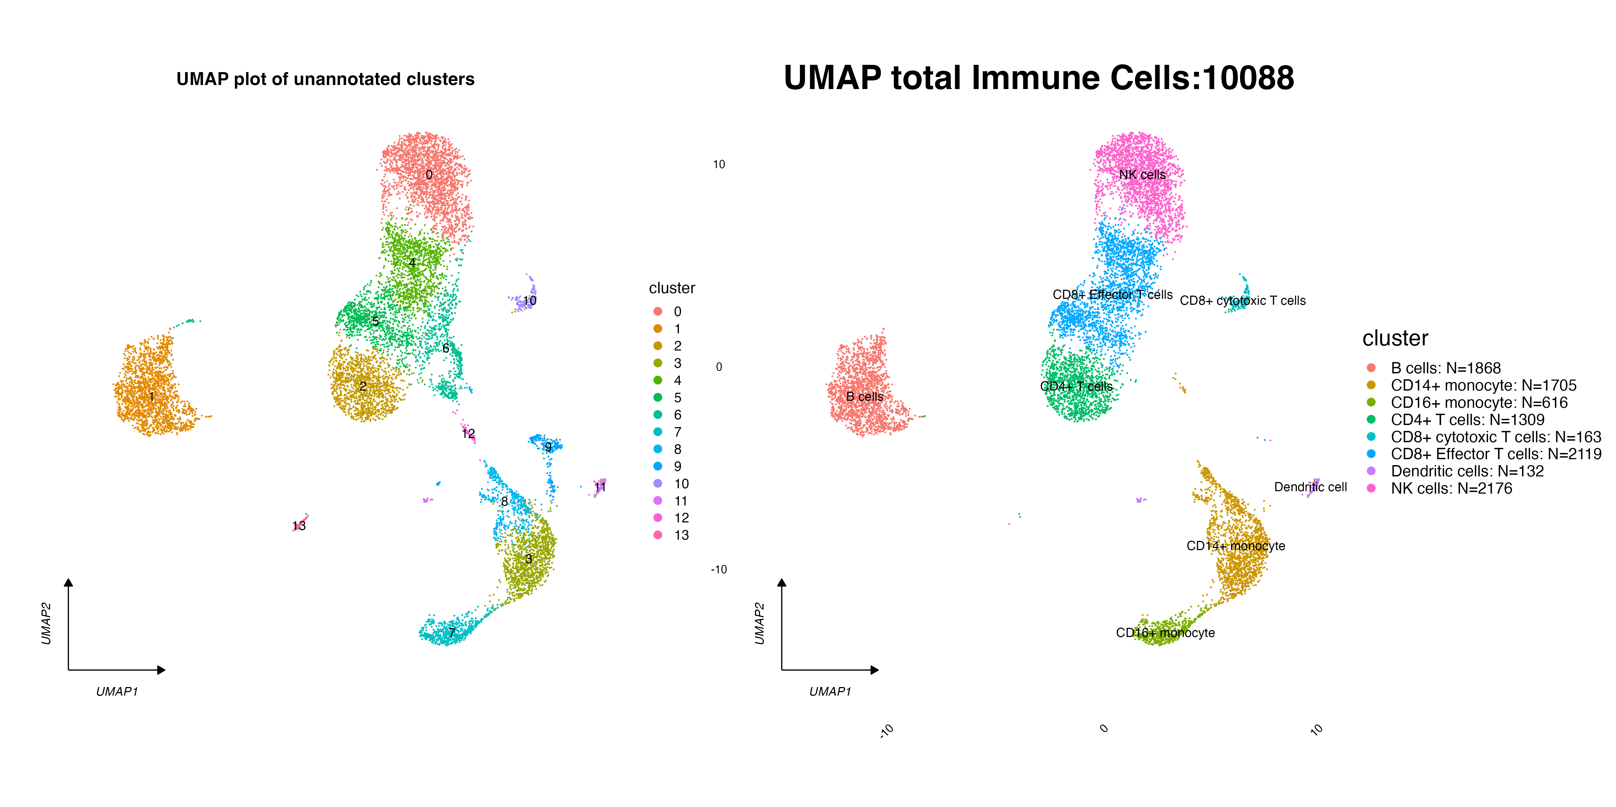
UMAP of Cell Type Annotation

Slide 11
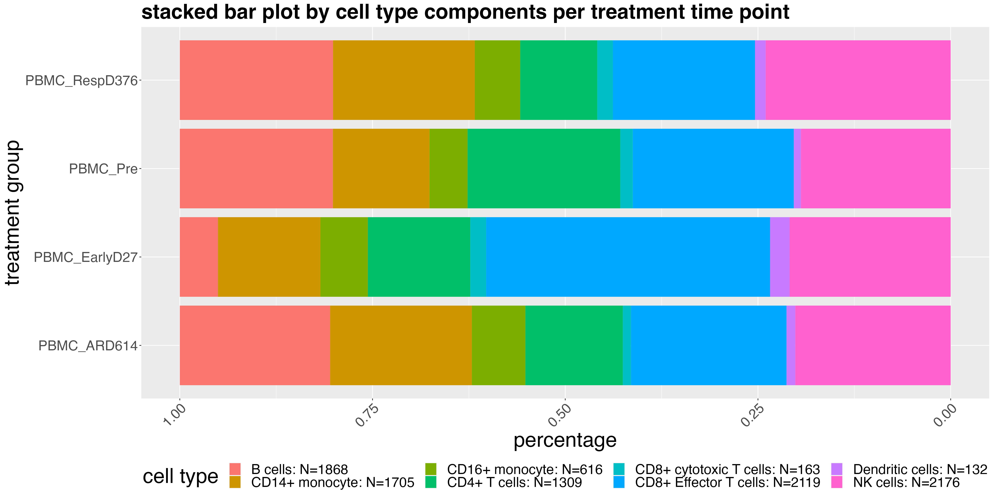
Cell type composition changes during the course of treatment

Slide 12
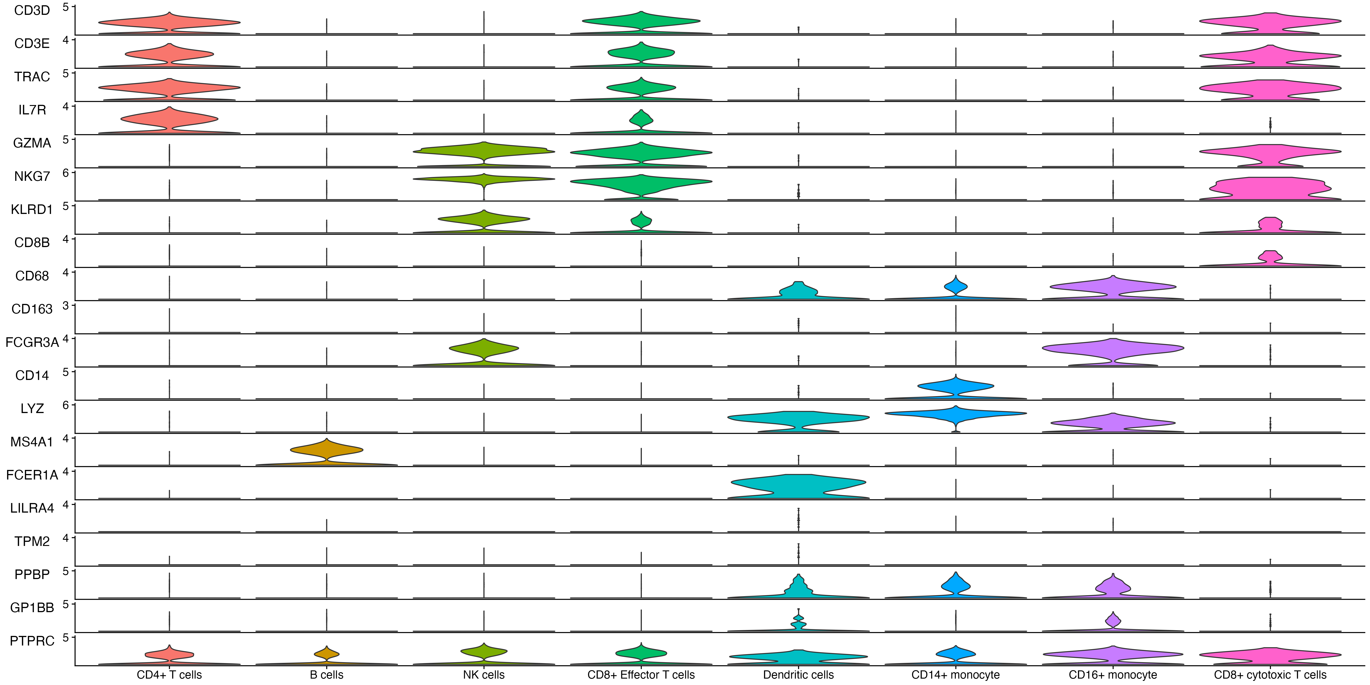
Stacked Violin Plot reveals marker genes per cell type

Slide 13
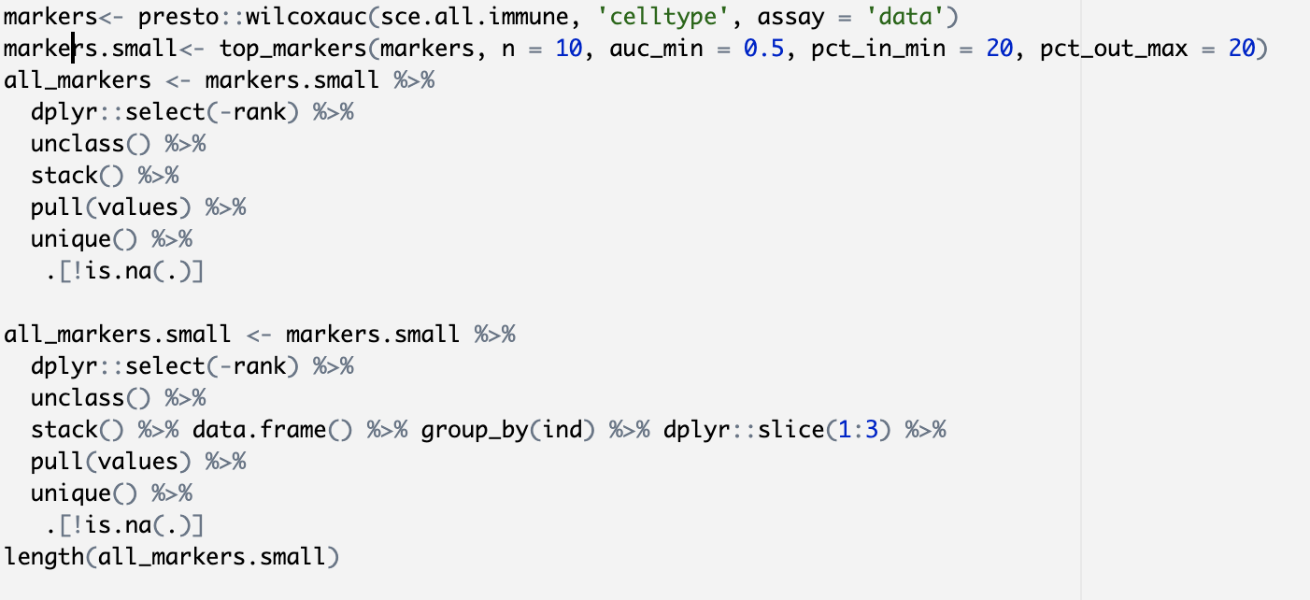
Presto is much faster to find marker genes using wilcox auc

Slide 14
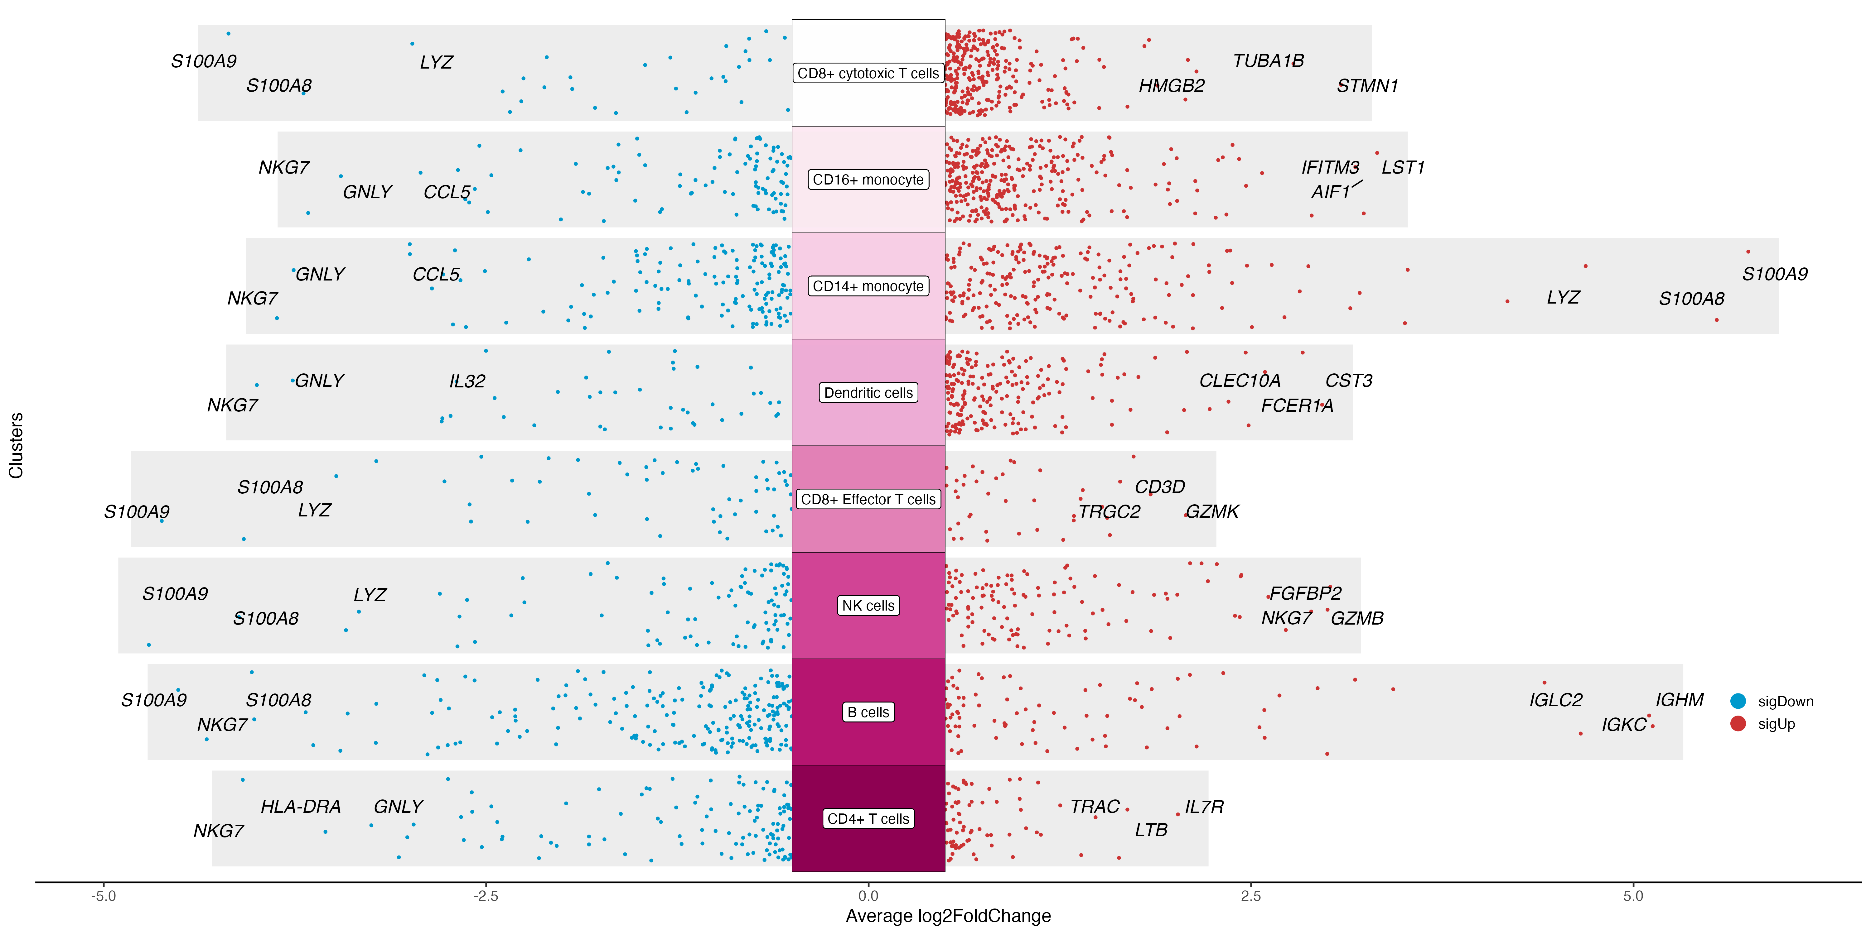
Volcano plot of Top Gene markers for each cell type

Slide 15
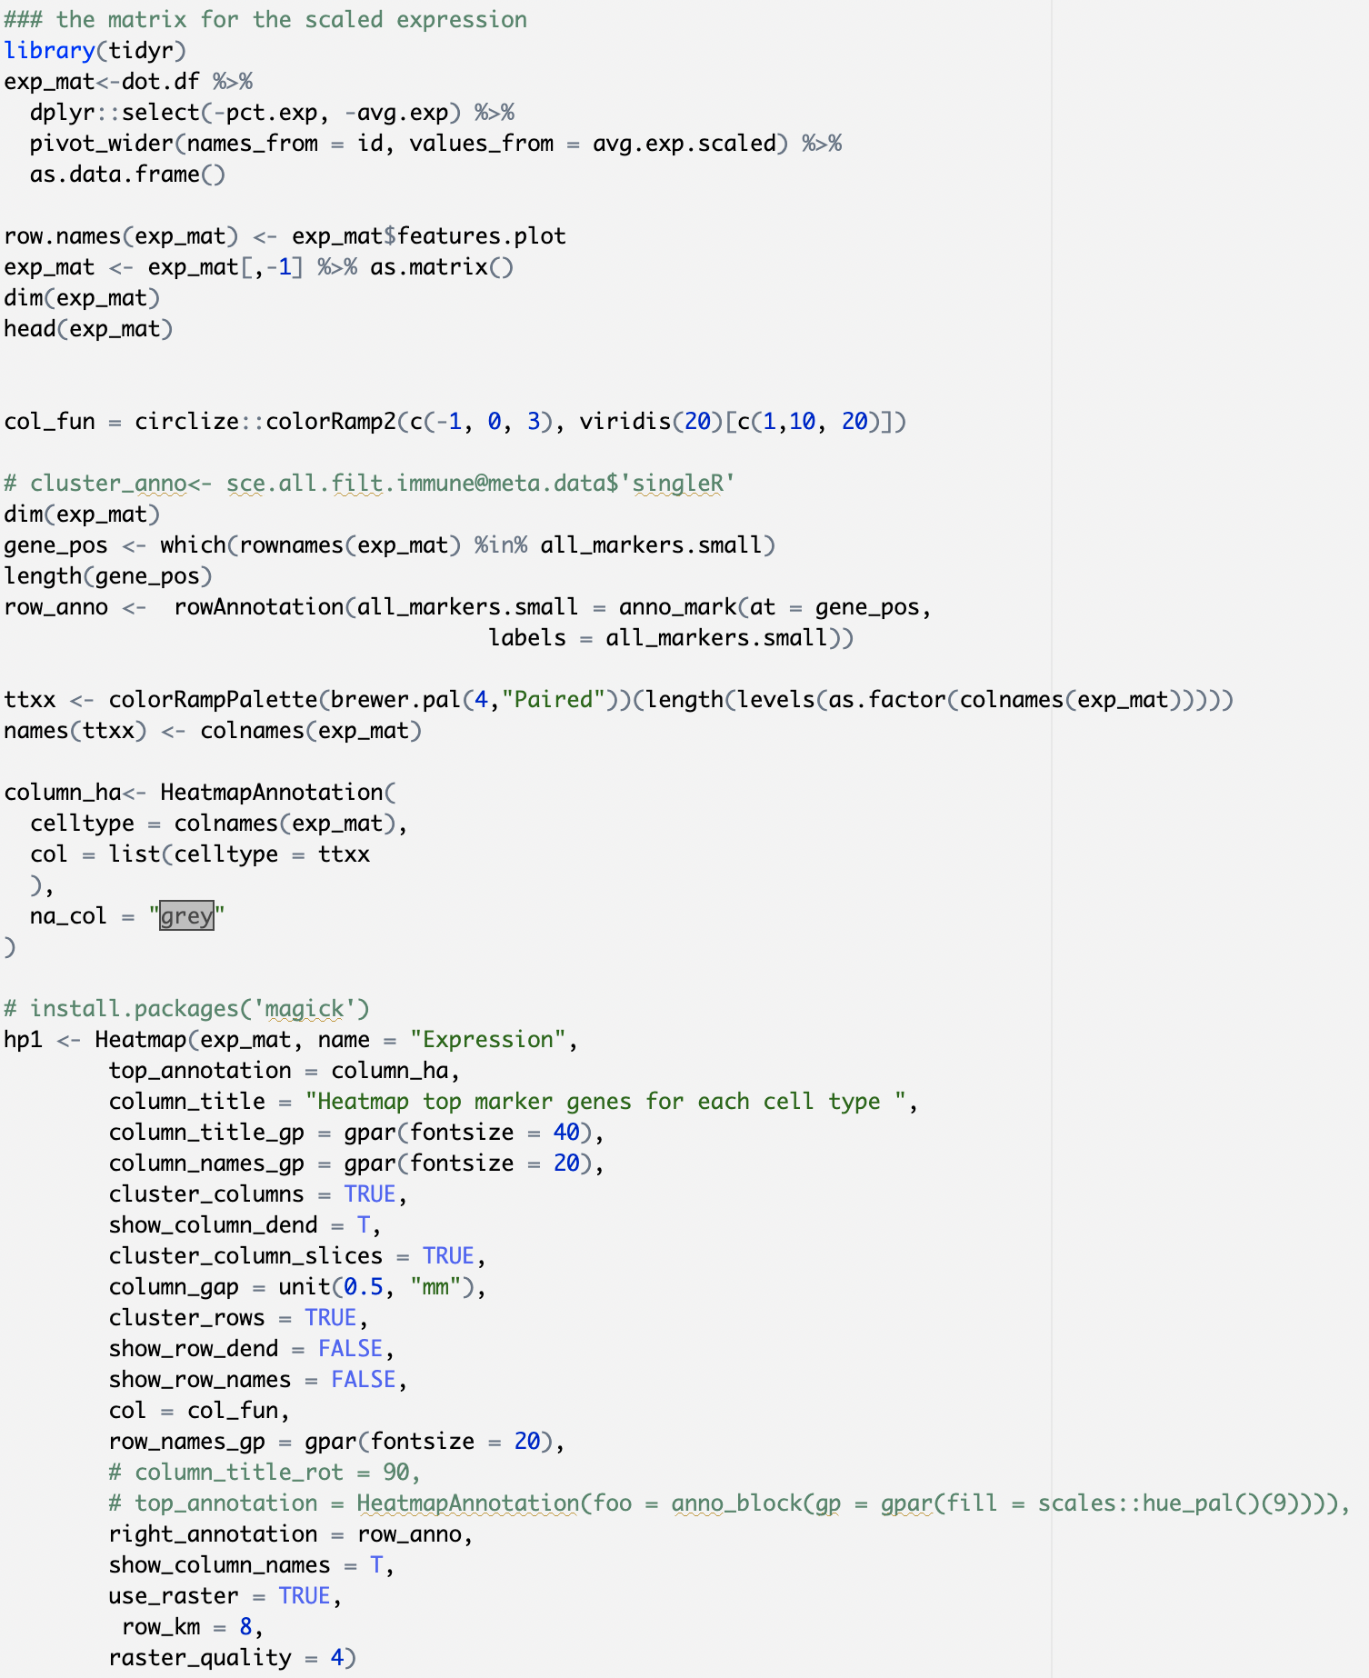
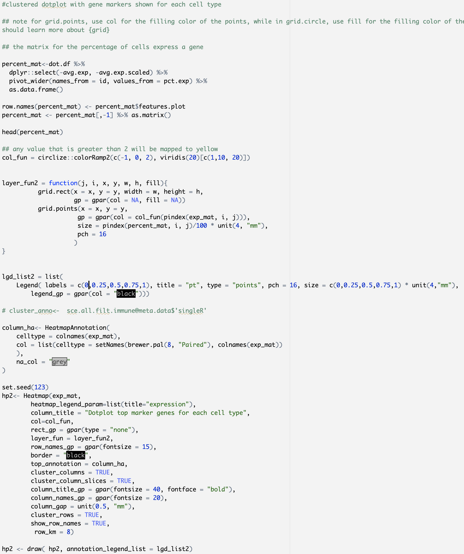
Exemplary script to generate heatmap, Dotplot

Slide 16
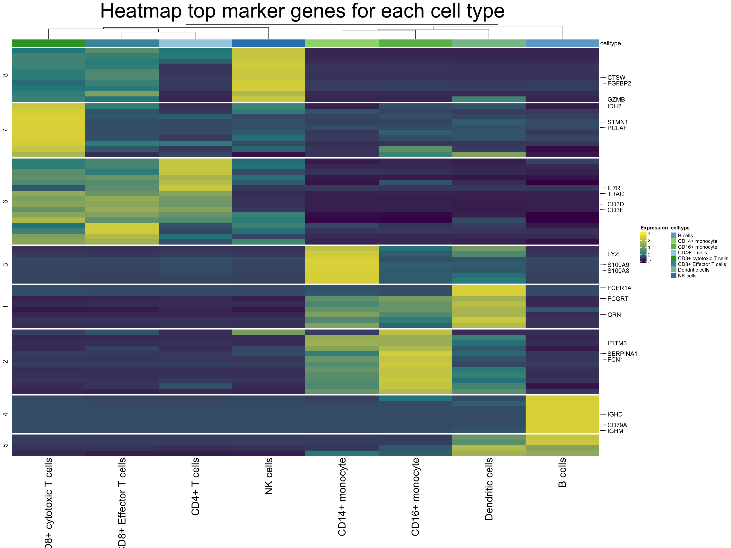
Heatmap reveals top marker genes for each cell type

Slide 17
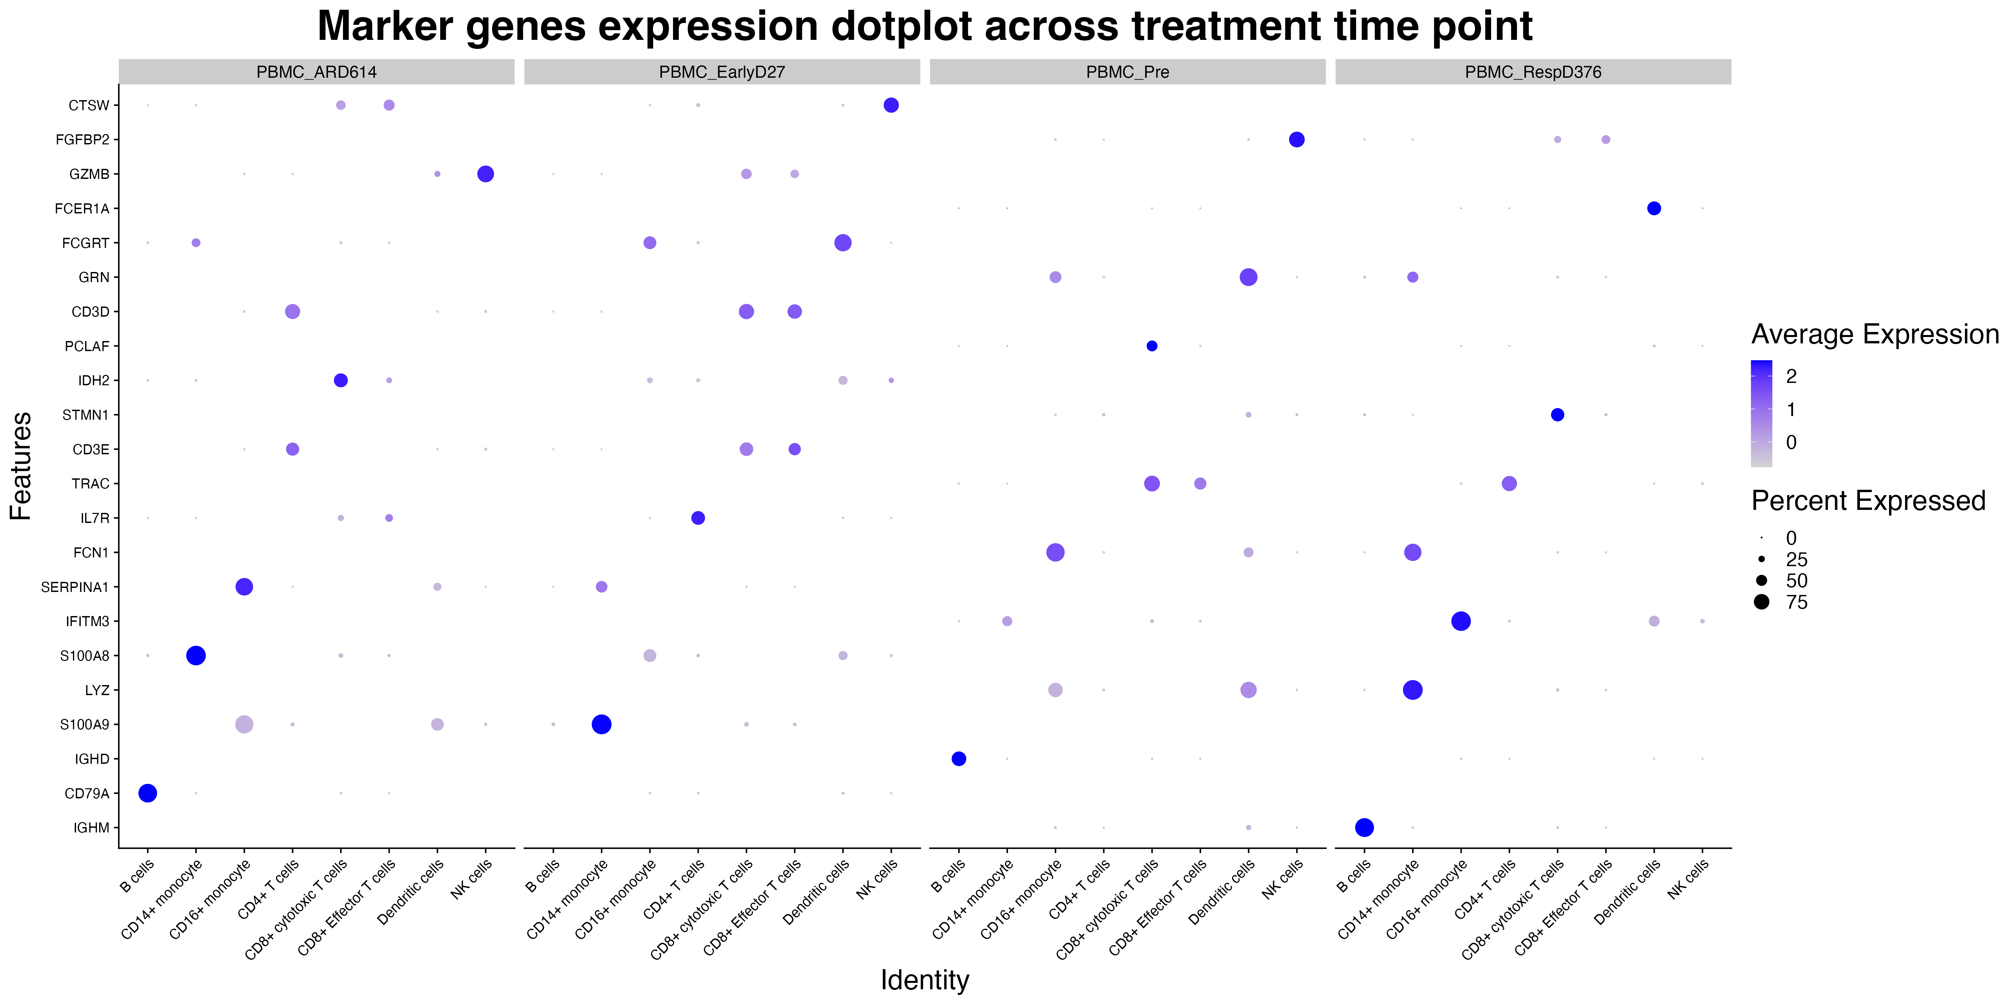
Top 3 marker gene expression per cell type reveals major cell type involvement across treatment time

Slide 18
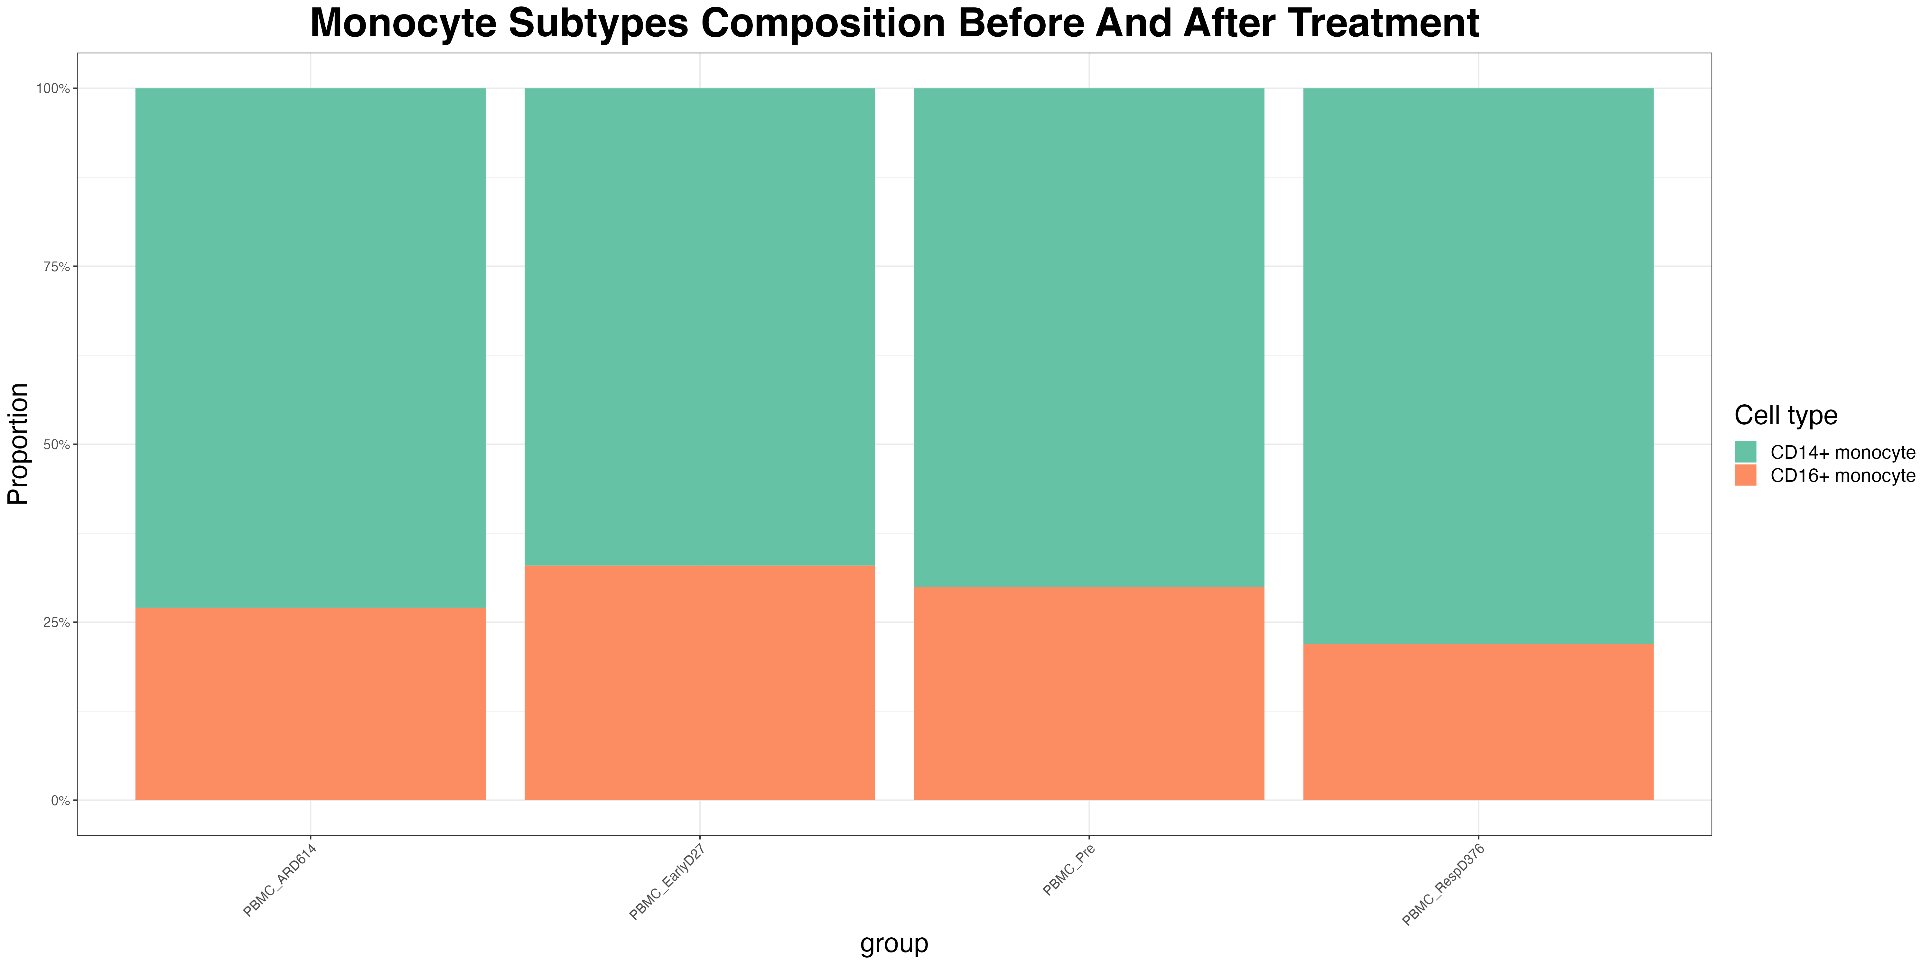
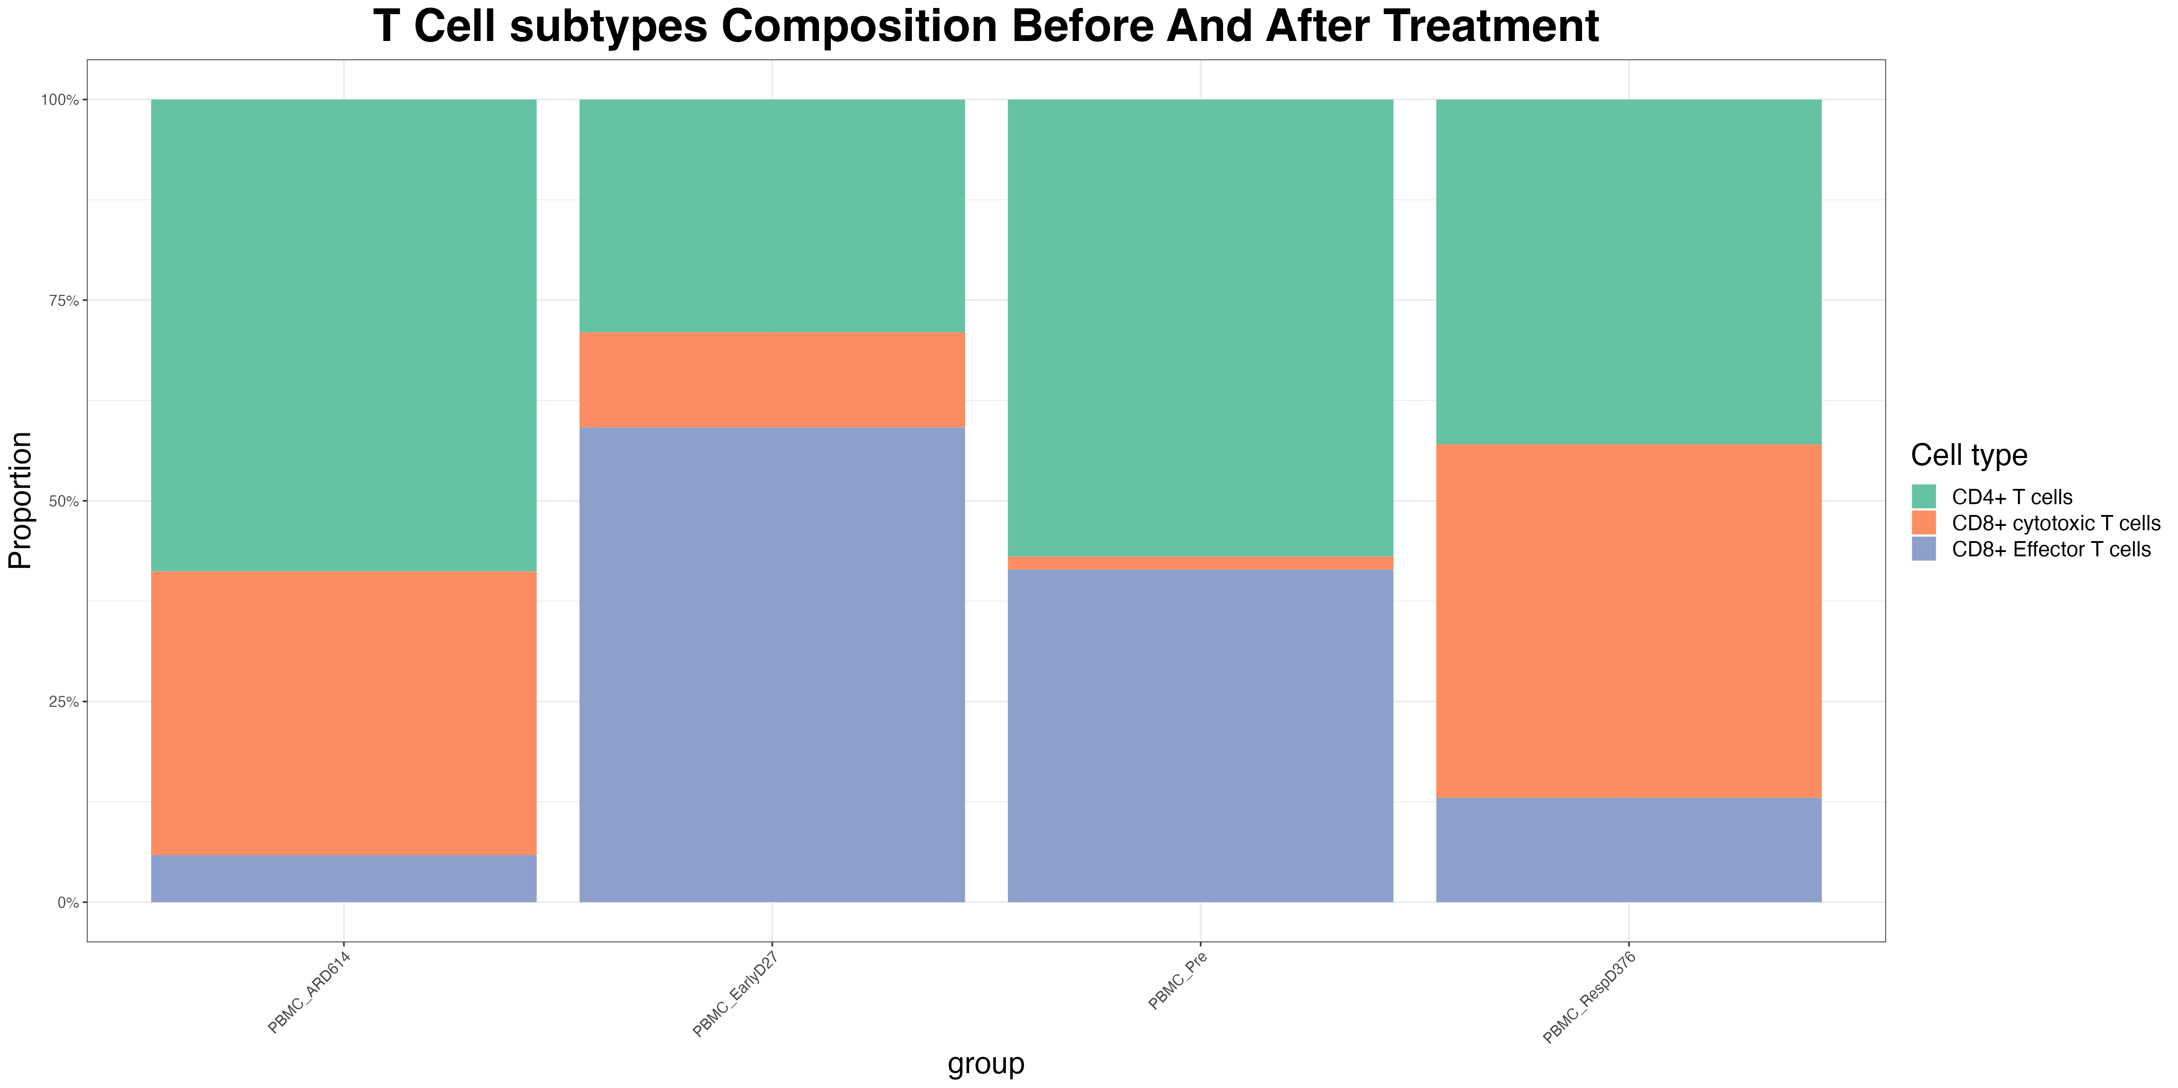
Monocyte and T cell composition
before treatment most CD4, almost no CD8 cytotoxic; early has lots of CD8 effector; after 37 days post treatment lots of CD8 cytotoxic, but relaps exausts CD8 effector (short-life), reduce prop of CD8 cytotoxic and form more CD4

Slide 19
Conclusion and discussion
Before treatment most CD4, almost no CD8 cytotoxic; early has lots of CD8 effector; after 37 days post treatment lots of CD8 cytotoxic, but relaps exausts CD8 effector (short-life), reduce prop of CD8 cytotoxic aand form more CD4
majority CD14 mono (Classic) as expected as phagocytic, but early post treatment illustrated a increase prop of non-classical CD16 pro-inflammatory; long after treatment non-classical diminished; increased a bit when relaps

Slide 20
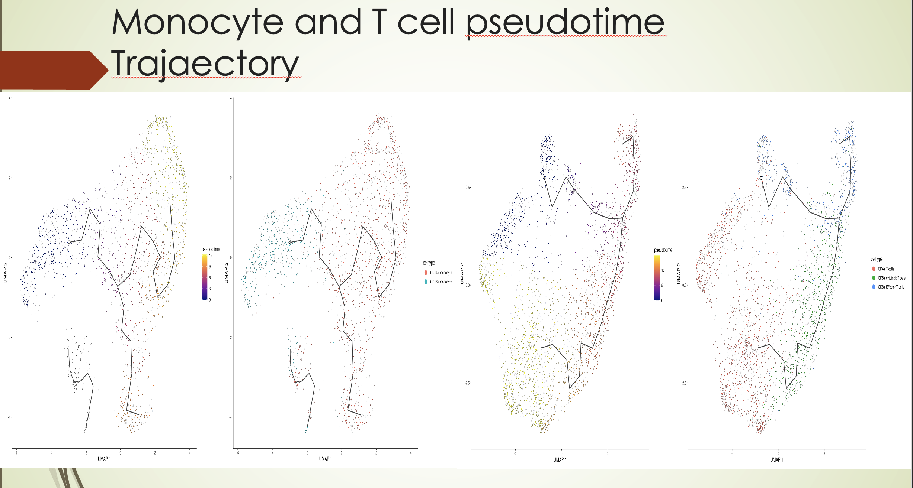
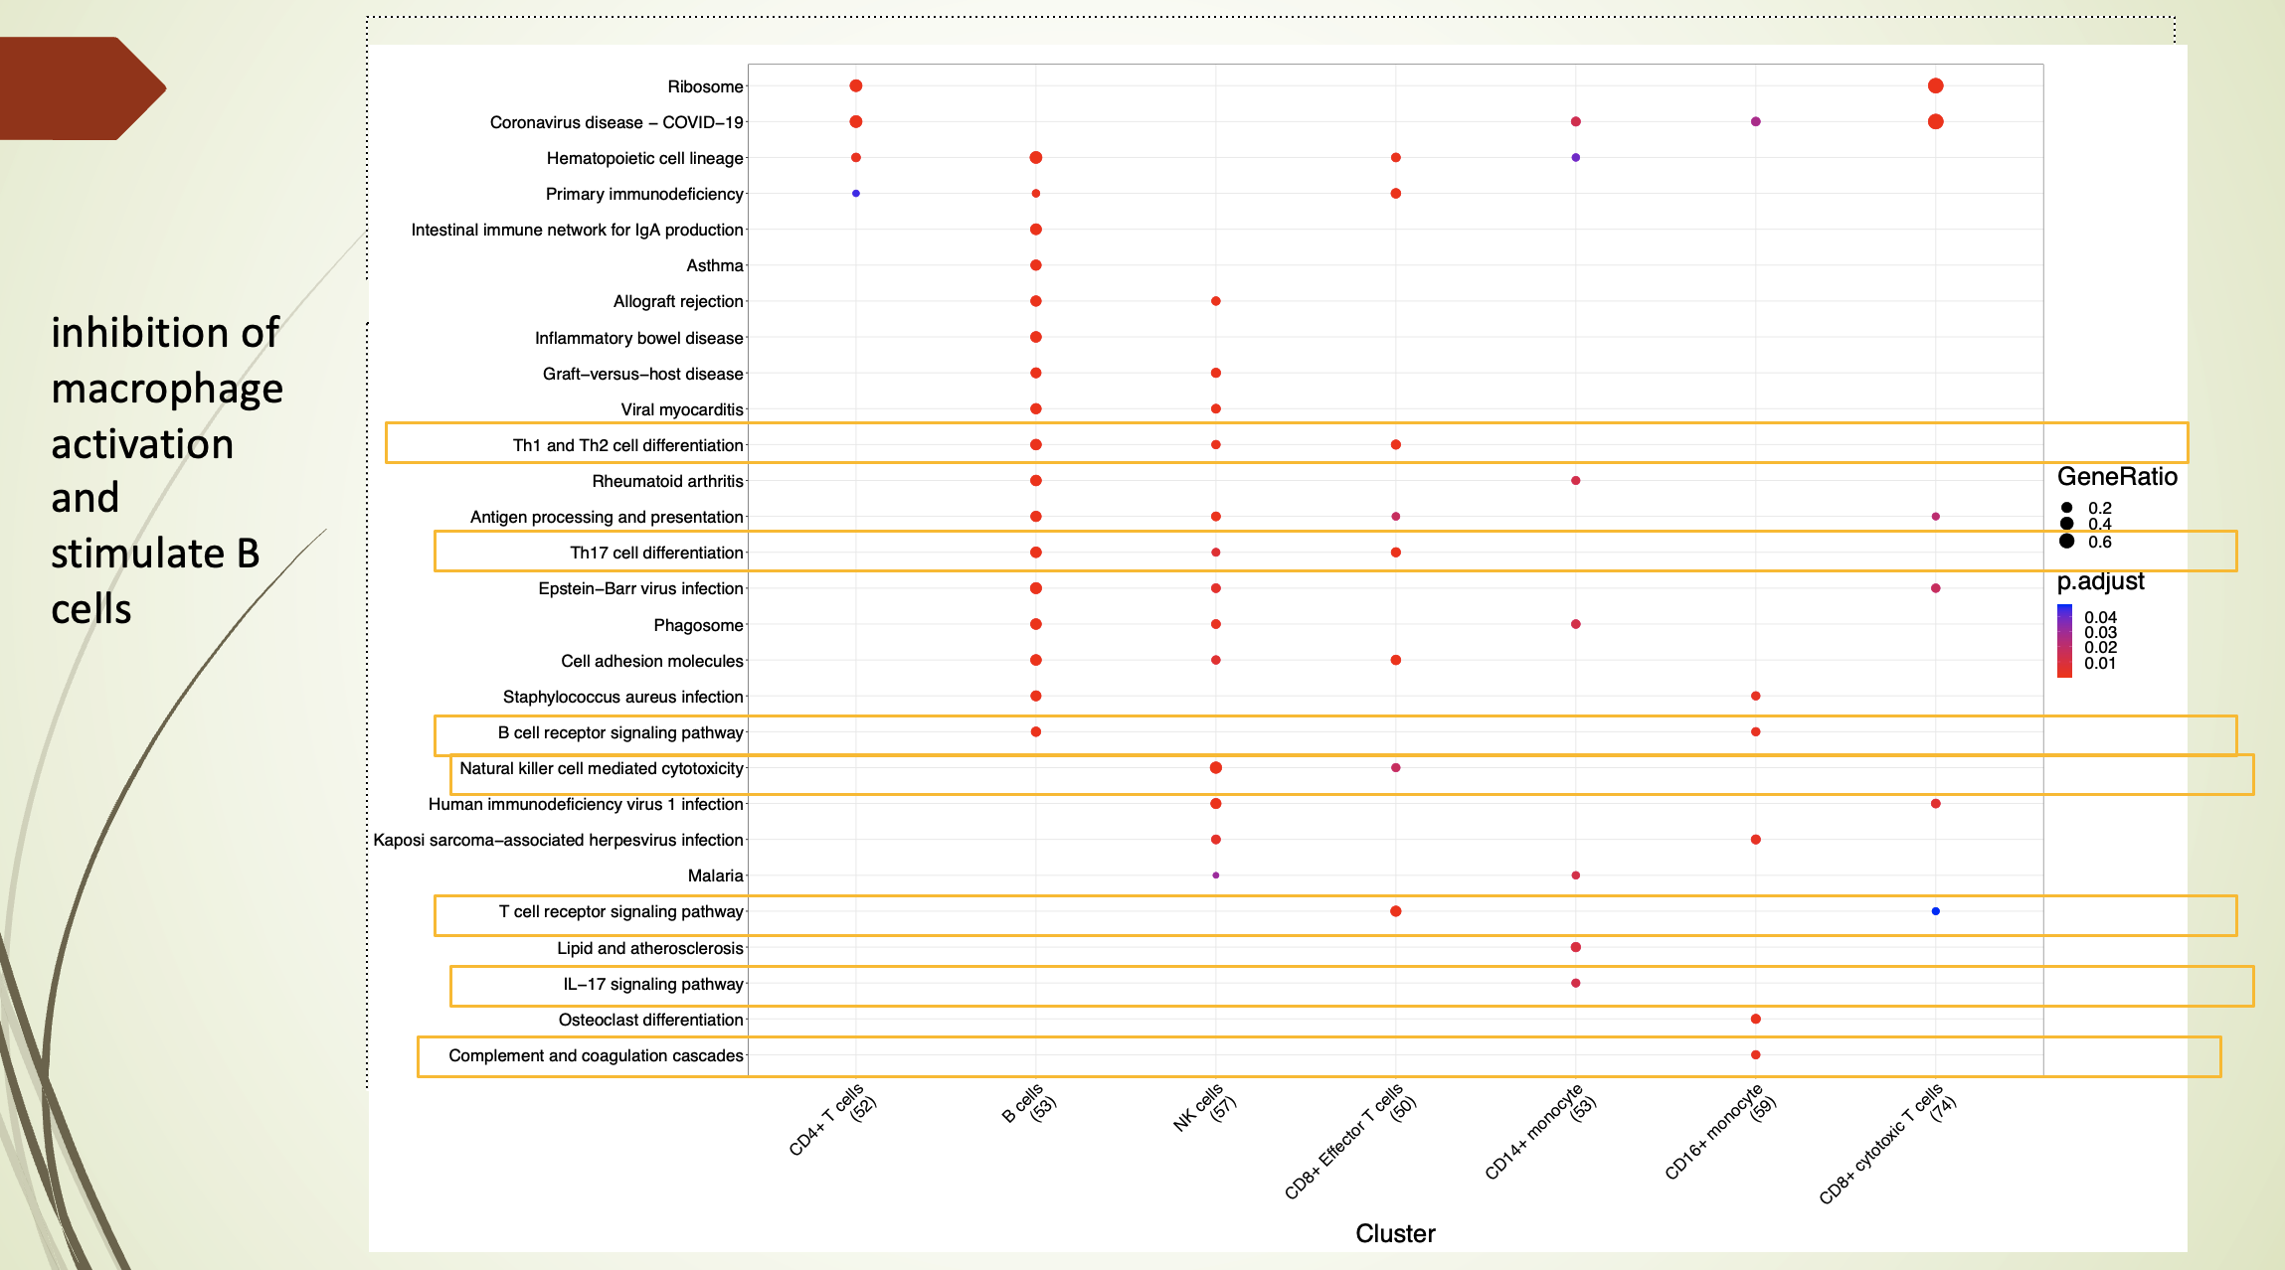
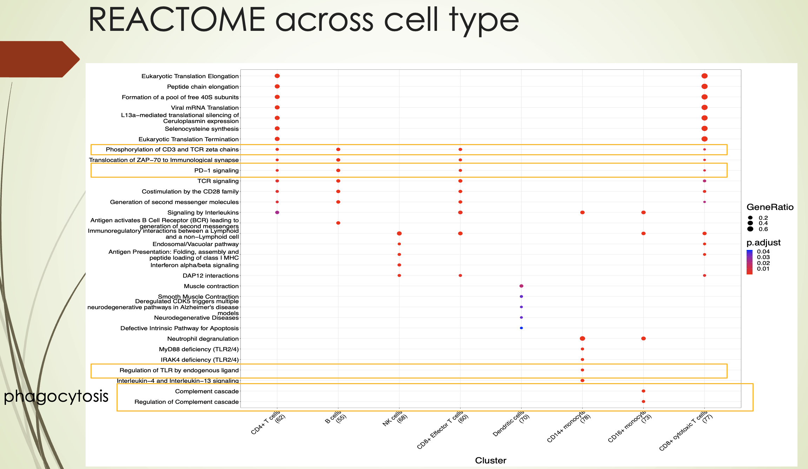
Discussion and future direction
Advanced analysis to answer questions like:
What are pathways enriched per cell types
Pseudobulk to interrogate at population level of DEGs
Trajectory analysis of specific subtype of cell cluster
Cell-cell communication

